Slide 1
About Me
Ritesh Singh
Sun Certified java Professional
Oracle Certified Database Administrator
Certified Ethical Hacker
Certified EC-Council Instructor (CEI)

Slide 2
Course Overview
What is an Use-Case Diagram?
Why Use-Case diagram?
Use-case diagram notations
Tips for drawing a use-case diagram
When to use a use-case diagram?

Slide 3
What is the Use Case Diagram?
Use Case Diagram captures the system's functionality and requirements by using actors and use cases. Use Cases model the services, tasks, function that a system needs to perform. Use cases represent high-level functionalities and how a user will handle the system. Use-cases are the core concepts of Unified Modelling language modeling.

Slide 4
Why Use-Case diagram?
A Use Case consists of use cases, persons, or various things that are invoking the features called as actors and the elements that are responsible for implementing the use cases. Use case diagrams capture the dynamic behaviour of a live system. It models how an external entity interacts with the system to make it work. Use case diagrams are responsible for visualizing the external things that interact with the part of the system.

Slide 5
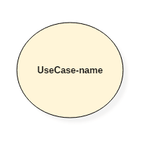
Use-case diagram notations
Use-case:
Use cases are used to represent high-level functionalities and how the user will handle the system. A use case represents a distinct functionality of a system, a component, a package, or a class. It is denoted by an oval shape with the name of a use case written inside the oval shape. The notation of a use case in UML is given below:

Slide 6
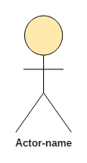
Actor
It is used inside use case diagrams. The actor is an entity that interacts with the system. A user is the best example of an actor. An actor is an entity that initiates the use case from outside the scope of a use case. It can be any element that can trigger an interaction with the use case. One actor can be associated with multiple use cases in the system. The actor notation in UML is given below.

Slide 7
How to draw a use-case diagram?
Following rules must be followed while drawing use-case for any system:
The name of an actor or a use case must be meaningful and relevant to the system.
Interaction of an actor with the use case must be defined clearly and in an understandable way.
Annotations must be used wherever they are required.
If a use case or an actor has multiple relationships, then only significant interactions must be displayed.

Slide 8
Tips for drawing a use-case diagram
A use case diagram should be as simple as possible.
A use case diagram should be complete.
A use case diagram should represent all interactions with the use case.
If there are too many use cases or actors, then only the essential use cases should be represented.
A use case diagram should describe at least a single module of a system.
If the use case diagram is large, then it should be generalized.

Slide 9
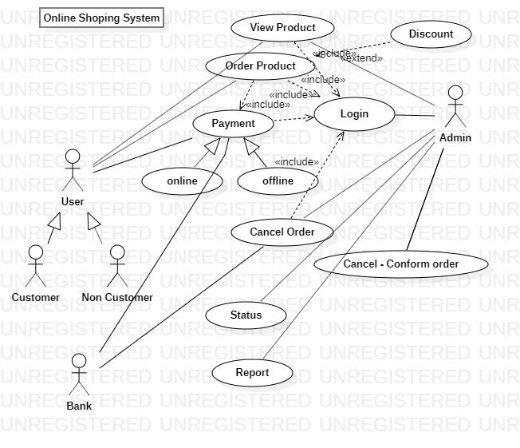
An example of a use-case diagram

Slide 10
When to use a use-case diagram?
In general use case diagrams are used for:
Analyzing the requirements of a system
High-level visual software designing
Capturing the functionalities of a system
Modeling the basic idea behind the system
Forward and reverse engineering of a system using various test cases.
Use cases are intended to convey desired functionality so the exact scope of a use case may vary according to the system and the purpose of creating UML model.

Slide 11
Summary
Use case diagrams are a way to capture the system's functionality and requirements in UML diagrams.
It captures the dynamic behavior of a live system.
A use case diagram consists of a use case and an actor.
A use case represents a distinct functionality of a system, a component, a package, or a class.
An actor is an entity that initiates the use case from outside the scope of a use case.
The name of an actor or a use case must be meaningful and relevant to the system.
A purpose of use case diagram is to capture the core functionalities of a system.

